Slide 1
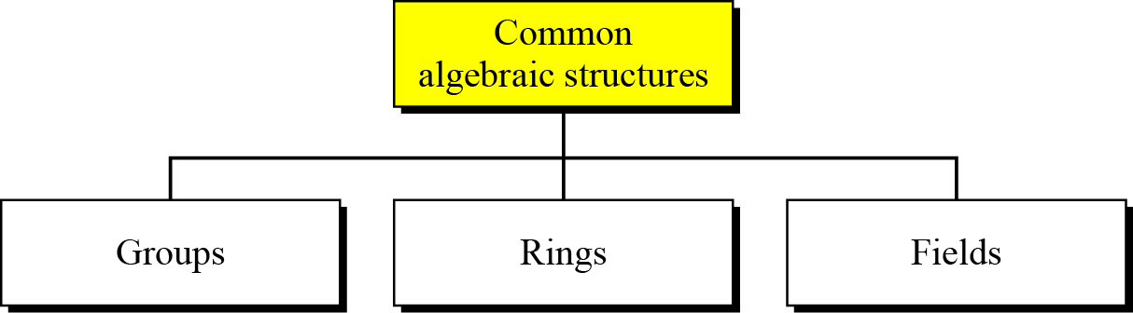
Algebraic Structures
Cryptography requires sets of integers and specific operations that are defined for those sets.
The combination of the set and the operations that are applied to the elements of the set is called an algebraic structure.
Figure 1 Common algebraic structures

Slide 2
Groups
A group (G) is a set of elements with a binary operation (•) that satisfies four properties (or axioms). A commutative group satisfies an extra property, commutativity:
Closure
If a,b are elements of G, then c =a.b is also an elt of G
Associativity
If a,b and c are elements of G, then
(a.b).c = a.(b.c)

Slide 3
Groups
Commutativity
For all a and b in G, a.b = b.a
To be satisfied for only a Commutative group
Existence of Identity
For all a in G, there exists an elt e called the identity elt
s.t. e.a =a.e. = a
Existence of Inverse
For all a in G, there exists an elt a` called the inverse of a s.t a.a` = a`.a =e

Slide 4
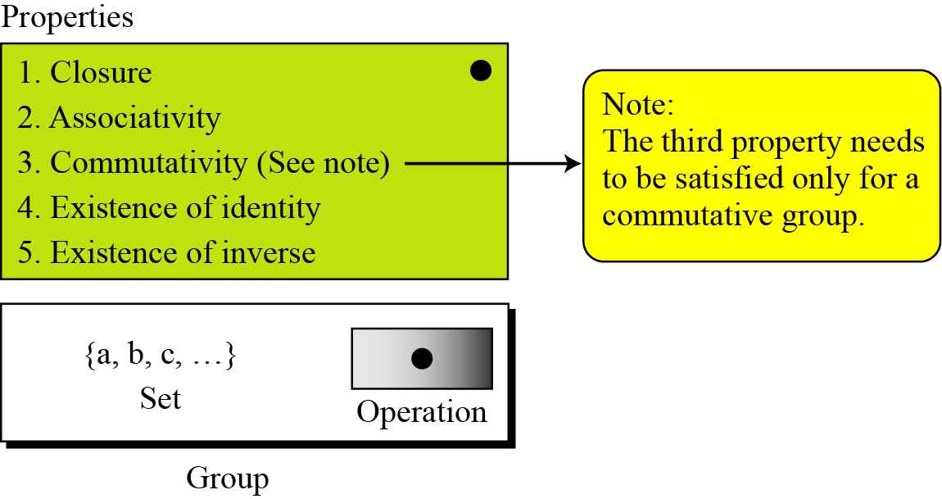
Contd…
Fig 2. Group

Slide 5
Contd…
Application
Although a group involves a single operation, the properties imposed on the operation allows the use of a pair of operations as long as they are inverses of each other.
Example
Addition - Additive inverse
Subtraction -
Multiplication – Multiplicative inverse
Division
+/- or */÷

Slide 6
Contd…
Example
The set of residue integers with the addition operator,
G =< Z_{n} , +>,
is a commutative group /Abelian group
addition and subtraction can be performed on the elements of this set without moving out of the set.

Slide 7
Contd…
Find out whether the set Zn* with the multiplication operator, G = <Zn*, *>, is an abelian group.
n = 7 / 12

Slide 8
Contd…
Find out whether a set G = <{a,b,c,d}, . >, with operation table given below is a group.

Slide 9
Groups
A group is called as a finite group if it has finite number of elements, otherwise an infinite group
Order of a group G is |G| , number of elements present in the group.
Group finite- order finite
Group infinite- order infinite

Slide 10
Subgroups
A subset H of a group G is a subgroup of G if H itself is a group wrt the operation on G
If G = <S, .> is a group,
H = <T, .> is a group under the same operation and
T is a non empty subset of S,
then H is a subgroup of G

Slide 11
Subgroups
If a and b are members of both groups, then
c = a.b is also a member of both groups
The group share the same identity element
If a is a member of both groups, the inverse of a is also a member of both groups
The group made of the identity element of G,H=<{e}, . > is a subgroup of G
Each group is a subgroup of itself

Slide 12
Subgroups
Is the group H =< Z₁₀ , +> a subgroup of the group G = < Z₁₂ , +>?

Slide 13
Subgroups
Is the group H =< Z₁₀ , +> a subgroup of the group G = =< Z₁₂ , +>?
No
Y??????

Slide 14
Subgroups
Is the group H =< Z₁₀ , +> a subgroup of the group G = =< Z₁₂ , +>?
No
H is a subset of G but the operations defined for these two groups are different
In H, it is addition mod 10 and in G , it is addition mod 12

Slide 15
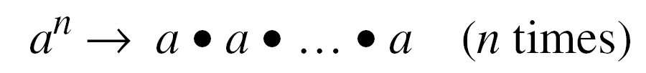
Cyclic Subgroup
If a subgroup of a group can be generated using the power of an element, the subgroup is called the cyclic subgroup.
Power – repeatedly applying the group operation to the element
Set made from these operations is <a>
with duplicate elements discarded
a ⁰ = e

Slide 16
Cyclic Subgroups
Given a group G = < Z₆ , +>, find out its cyclic subgroups

Slide 17
Cyclic Subgroups
Given a group G = < Z₆ , +>, find out its cyclic subgroups
Z₆ = {0,1,2,3,4,5}

Slide 18
Cyclic Subgroups
Given a group G = < Z₆ , +>, find out its cyclic subgroups
Z₆ = {0,1,2,3,4,5}
Cyclic SG generated from 0 is H₁
0 ⁰ mod 6 = 0 ( repeated any no of times)
H₁ = < {0} , +> and |H₁| = 1

Slide 19
Cyclic Subgroups
Other cyclic subgroups ???

Slide 20
Cyclic Subgroups
Given a group G = < Z₁₀ , *>, find out its cyclic subgroups

Slide 21
Cyclic Group
A cyclic group is a group that is its own cyclic subgroup.
Eg H₄ = G, hence G is a Cyclic group
Elt that generates the cyclic group can also generate the Group – generator / many generators
If g is the generator, then the elts in a finite cyclic group can be written as

Slide 22
Cyclic groups
Find out the generators of
1. G = < Z₆ , +>,
2. G = < Z₁₀ , *>,

Slide 23
Lagrange’s Theorem
Relates the order of a group to the order of its subgroup
Assume that G is a group, and H is a subgroup of G. If the order of G and H are |G| and |H|, respectively, then, based on this theorem, |H| divides |G|.

Slide 24
Lagrange’s Theorem
Eg.Given G = < Z₆ , +>,
Order of G is |G| = 6
The order of the subgroups are
| H₁| =1 | H₂| = 3 | H₃| =2 | H₄| =6
All these orders divide 6

Slide 25
Lagrange’s Theorem
The order of potential subgroups can be found if the divisors of |G|. are known
Given G = < Z₁₇ , +>, |G| = 17
Only divisors of 17 are 1 and 17
Means this G can have only two subgrouprs H₁ with identity element and H₂ = G

Slide 26
Lagrange’s Theorem
Order of an Element
The order of an element is the order of the cyclic group it generates.
ord(a) is the smallest integer n s.t. a^{n} = e
Find out the order of elements in
G = < Z₆ , +>,
G = < Z₁₀ * , *>,

Slide 27
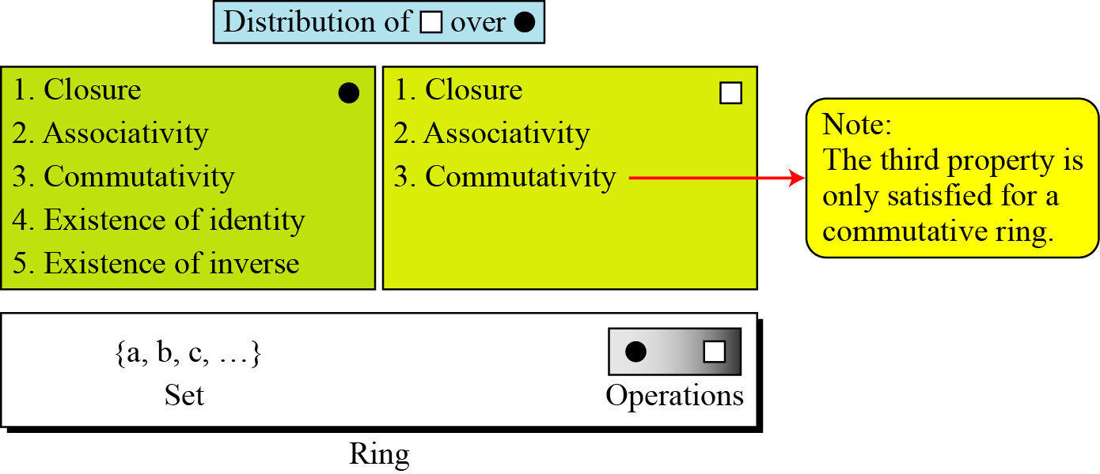
Ring
A ring, R = <{…}, •,□ >, is an algebraic structure with two operations.
1st oprn – all 5 properties- Abelian group
2nd oprn –only the first 2 properties; 2nd distributed over 1st
Figure 4 Ring

Slide 28
Ring
Distributivity
A commutative ring is a ring in which the commutative property is also satisfied for the second operation

Slide 29
Ring
Find out whether the set Z with two operations + and * is a commutative ring

Slide 30
Ring
Find out whether the set Z with two operations + and – is a commutative ring
R = < Z,+,*>
Addition satisfies all the 5 properties
Mul satisfies only 3 properties
Division not possible

Slide 31
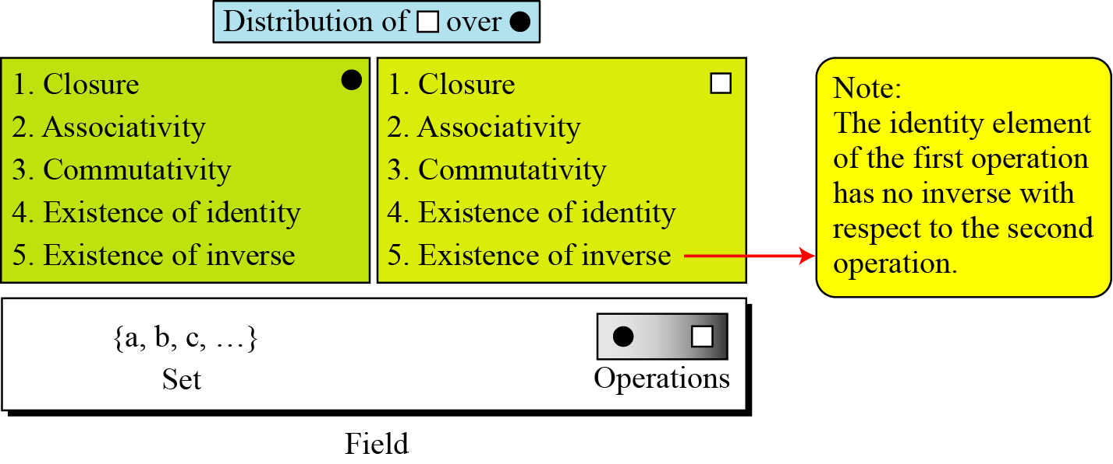
Field
A field, denoted by F = <{…}, •,□ > is a commutative ring in which the second operation satisfies all five properties defined for the first operation except that the identity of the first operation ( sometimes called zero element)has no inverse.
Figure 5 Field

Slide 32
Field
Application
A Field is a structure that supports 2 pairs of operations
+/- and */div
Division by 0 not allowed - Exception

Slide 33
Finite Fields
Is a field with finite number of elements
Galois showed that for a field to be finite, the number of elements should be p^{n}, where p is a prime and n is a positive integer.
A Galois field, GF(p^{n}), is a finite field with p^{n} elements.
GF(p) Field
When n = 1, we have GF(p) field.
This field can be the set Z_{p}, {0, 1, …, p − 1}, with two arithmetic operations.( + and *)
Each elt has an additive inverse and nonzero elements have multiplicative inverse

Slide 34
Finite Fields
Eg Find out whether GF(2) = {0,1} with 2 operations + and * is a finite field.
GF (5) = ????

Slide 35
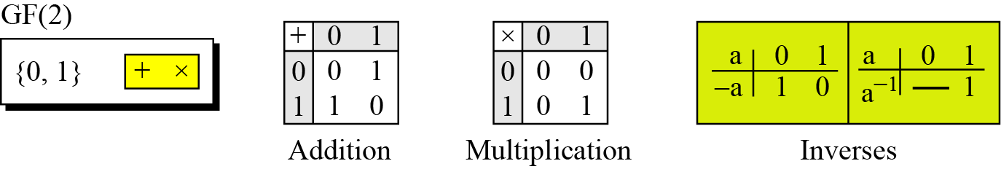
Contd…
A very common field in this category is GF(2) with the set {0, 1} and two operations, addition and multiplication
GF(2) field

Slide 36
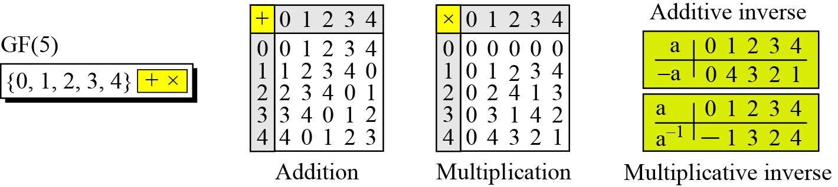
Contd…
Define GF(5) on the set Z₅ (5 is a prime) with addition and multiplication operators.
GF(5) field

Slide 37
Summary

Slide 38
GF(2^{n}) Fields
In Cryptography, four operations are required
+,-,* and / ---Hence fields
Computer n bit no – range is 0 to 2^{n} -1
Modulus is 2^{n} ; hence 2 choices to use fields
1. Use GF(p) with the set Z_{p} where p is the largest prime no less than 2^{n}
n = 4, n=8
2. Use GF(2^{n}) with 2^{n} elements

Slide 39
Contd…
Define a GF(2²) field in which the set has four 2-bit words: {00, 01, 10, 11}.
We can redefine addition and multiplication for this field in such a way that all properties of these operations are satisfied

Slide 40
Contd…
Define a GF(2²) field in which the set has four 2-bit words: {00, 01, 10, 11}.
We can redefine addition and multiplication for this field in such a way that all properties of these operations are satisfied

Slide 41
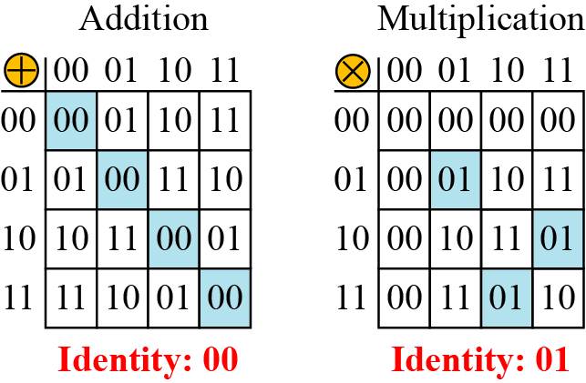
Contd…
Define a GF(2²) field in which the set has four 2-bit words: {00, 01, 10, 11}.
We can redefine addition and multiplication for this field in such a way that all properties of these operations are satisfied

Slide 42
Polynomial
n bit word -polynomial of degree n − 1
A polynomial of degree n − 1 is an expression
of the form
where x^{i} is called the ith term and a_{i} is called coefficient of the ith term.

Slide 43
Polynomial
A polynomial of degree n − 1 is an expression
of the form
where x^{i} is called the ith term and a_{i} is called coefficient of the ith term.
Power of x – posn of the bit in n bit word
Coefficient- value of the bits

Slide 44
Contd…
Represent the 8-bit word (10011001) using a polynomial.

Slide 45
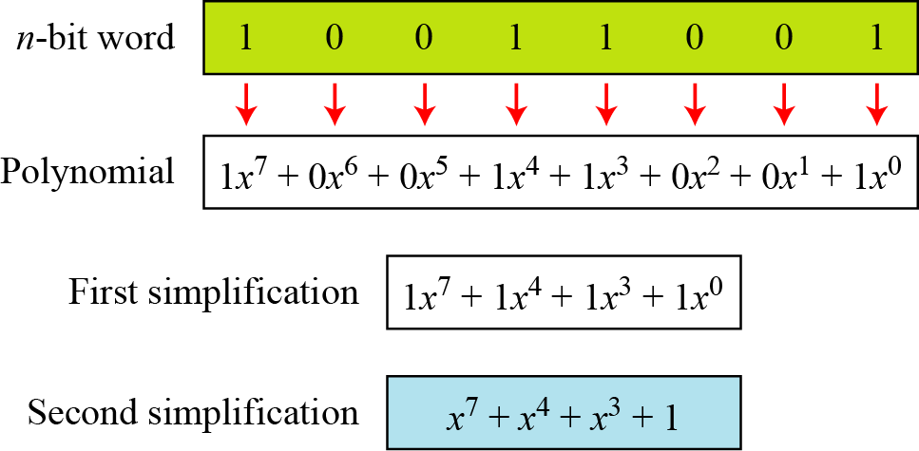
Contd…
Represent the 8-bit word (10011001) using a polynomial.

Slide 46
Contd…
Find the 8-bit word related polynomial x⁵ + x² + x.

Slide 47
Contd…
Find the 8-bit word related polynomial x⁵ + x² + x.
Since n = 8, it means the polynomial is of degree 7.
The expanded polynomial is
This is related to the 8-bit word 00100110.

Slide 48
Contd…
Any operation on polynomials
Operations on coefficients
One field – GF(2)- 0/1
Operation on 2 polynomials
Another field – GF(2^{n})

Slide 49
GF(2²)
identity that x^2=x+1
ab⋅cd=(a∗x+b)(c∗x+d)=(a∗c)x2+(a∗d+b∗c)x+b∗d=(a∗d+b∗c+a∗c)x+[b∗d+a∗c]
+ is xor
multiplication of the coefficients is the same as an AND operation &
ab⋅cd=(a&d⊕b&c⊕a&c)x⊕[b&d⊕a&c]=[a&d⊕b&c⊕a&c][b&d⊕a&c]

Slide 50
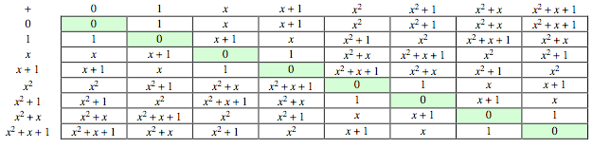
GF(2³)

Slide 51
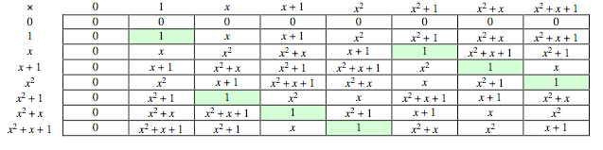
GF(2³)

